Slide 1
Lab Hours
Monday 6-9
Thursday 12-2.
Thursday 3:30-5

Slide 2
Lab 3: The IMU, The Gimbals, and the Motor
Due midnight, April 11th

Slide 3
Topics
Analog Inputs – How the microcontroller measure the position of the gimbals
Brushed Motors – How they work and how to drive them.
I2C – How the microcontroller and IMU communicate

Slide 4
I2C

Slide 5
Inter-Integrated Circuit (I²C) Bus Interface AKA: Two Wire Interface (TWI)

Slide 6
Brief History
Designed in 1982 by Philips Semiconductor (now NXP)
1992 - First public Spec released
Since 2006 no licensing fees are required
Widely adopted technology

Slide 7
Why I²C?
Pins are precious!
They take up space
More pins → More expensive microcontrollers
Adding pins is hard
Might need a new microcontroller (if a larger, compatible one is available)
Significant board changes
Performance is often not that important
So
Use the minimum number of pins
Run them at relatively low bit rates.

Slide 8
Applications
Connecting to all kinds of small, slow peripherals
Reading Configuration data from various devices (Memory, PCI cards)
Accessing ADCs and DACs
Reading from Real-time clocks
Reading hardware monitoring devices (Fan speed, CPU Temperature, Accelerometers)
Controlling power supplies for various system components
GPIO expanders
Many, many others

Slide 9
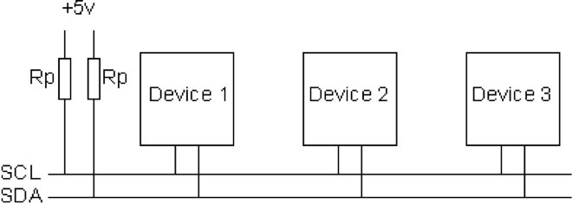
I²C Bus Architecture
Two signals
SCL – Serial Clock (used for coordination and timing)
SDA – Serial Data (used for data and control signaling)
You can have many peripherals
1 or more “masters” that initiate communication on the bus
Up to 127 “slaves” that master communicates with
Bit rates
100 KHz (Standard mode)
400 KHz (Fast Mode)
3.4 MHz (High speed mode)
1 MHz (Fast Mode Plus)
5 MHz (Ultra fast mode)

Slide 10

Masters and Slaves
Master
Slave
SCL
SDA
Masters
Can initiate transfers
Drives the SCL line
Normally only one Master
Slave
Can’t initiate transfers
Respond to the Master
Up to 100+ slaves per bus
Notes:
Engineers have weird terms for everything. Masters and Slaves. Zombie children, Victim blocks, Evicting cache lines etc.

Slide 11
I2C Protocol - Start/Stop
The Start/Stop sequences are the only times SDA can toggle while SCL is high
All other toggling of SDA must be done with SCL low

Slide 12
I²C Addressing
Each slave on an I²C bus has a unique address.
Most use 7 bit addresses (we discuss this here)
An extended 10-bit version also exists
Low-order bit determines whether it is a read or a write.
The addresses usually fixed or only partially configurable
E.g. Only the least-significant bit of the address for the IMU is settable. So you can only have two of these IMUs on one bus.
Different devices will have different numbers of settable and fixed bits.
You can’t mix components arbitrarily on the bus

Slide 13
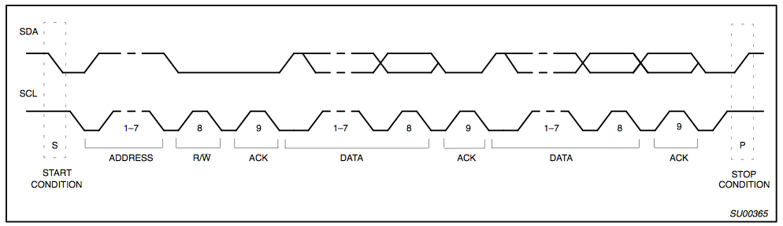
I2C Protocol - Full Xfer
Start
Philips I2C Bus Specification

Slide 14
I2C Protocol - Full Xfer
Address
R/W
Philips I2C Bus Specification

Slide 15
I2C Protocol - Full Xfer
Data
Philips I2C Bus Specification

Slide 16
I2C Protocol - Full Xfer
Stop
Philips I2C Bus Specification

Slide 17
I2C Speed
100 Kb/sec - Normal Operation
10 Kb/sec - Slow mode
400 Kb/sec to 3.4 Mb/sec - High Speed Modes

Slide 18
Clock Stretching
Only Masters can send clock pulses
But Slaves can stretch the clock if needed
Clock
Slave stretching the clock

Slide 19
Gimbals

Slide 20
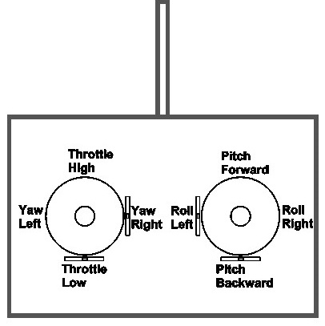
Controlling the Quadcopter
Standard RC “transmitters” have two sticks
Left: throttle and yaw
Right: pitch and roll
This is called “mode 2” It’s different in Europe where they use “mode 1”
Yaw, pitch, and roll are spring-loaded to return to neutral
Throttle stays where you put it.

Slide 21
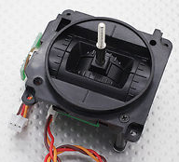
The Gimbals
Each stick is a “gimbal”
a mechanism, typically consisting of rings pivoted at right angles, for keeping an instrument such as a compass or chronometer horizontal in a moving vessel or aircraft. – The dictionary on my Mac

Slide 22
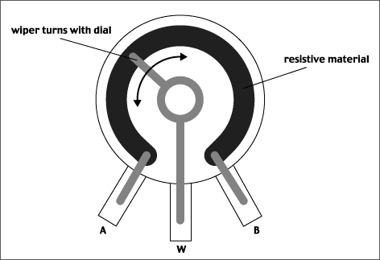
Anatomy of a Gimbal
Two potentiometers measure X and Y movement of the stick.
Potentiometer – A variable voltage divider
As the slider moves, the resistances between A and W and W and B change.
If A is at Vcc and B is at GND, then the voltage at W is proportional to the position of the gimbal.

Slide 23
Measuring the Gimbals
You need the analogread() function in arduino.
https://www.arduino.cc/en/Reference/AnalogRead

Slide 24
Brushed DC Motors

Slide 25
Brushed Motors

Slide 26
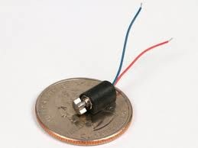
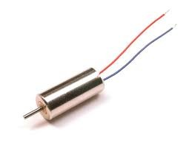
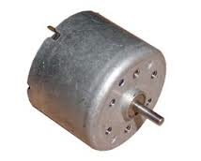
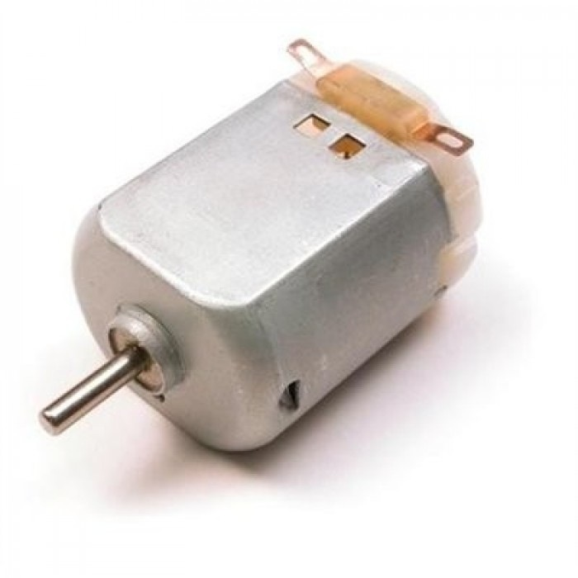
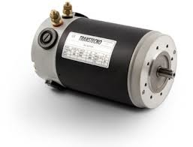
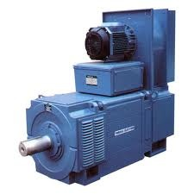
Brushed Motors

Slide 27
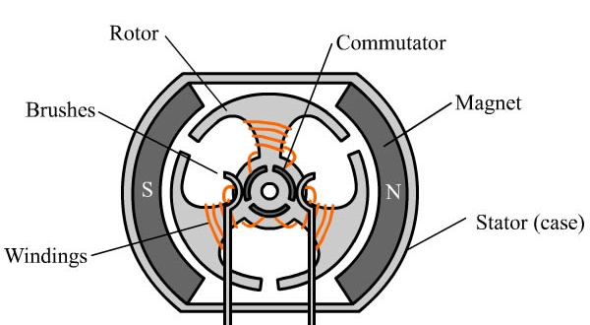
Construction

Slide 28
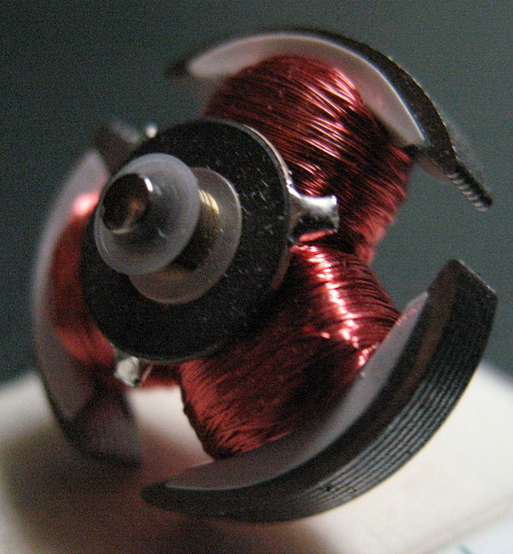
Construction (Rotor)

Slide 29
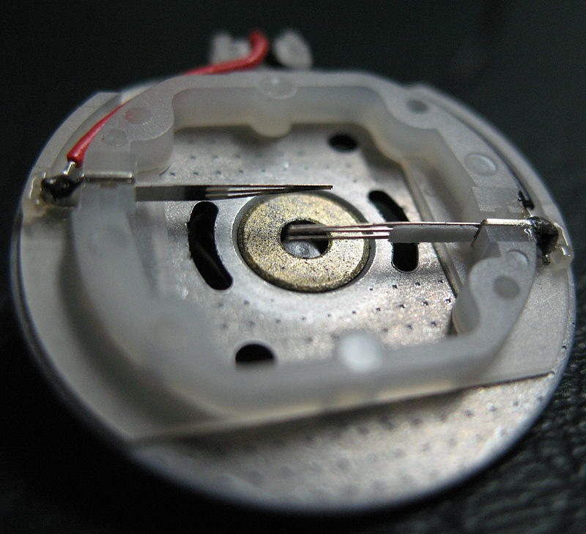
Construction (Stator)

Slide 30
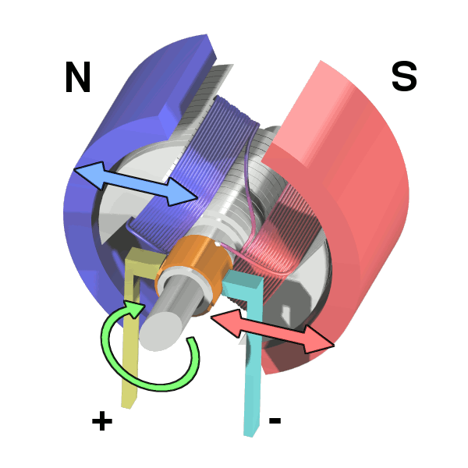
Operation

Slide 31
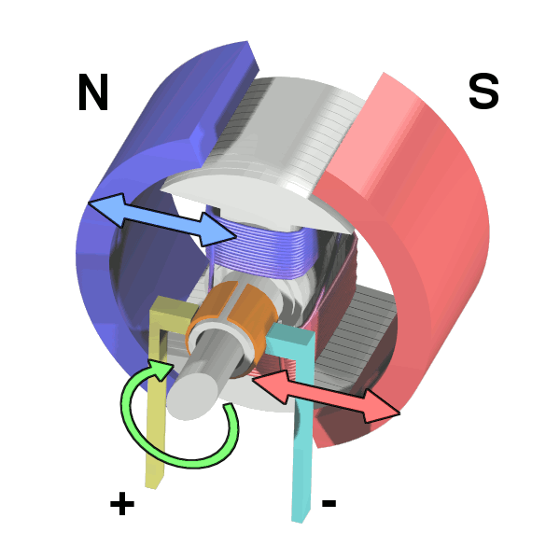
Operation

Slide 32
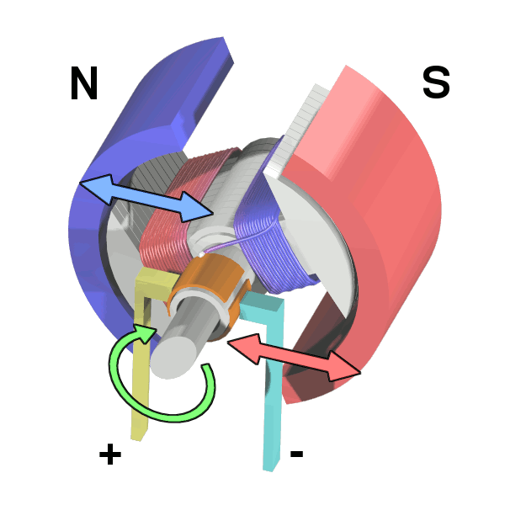
Operation

Slide 33
Operation

Slide 34
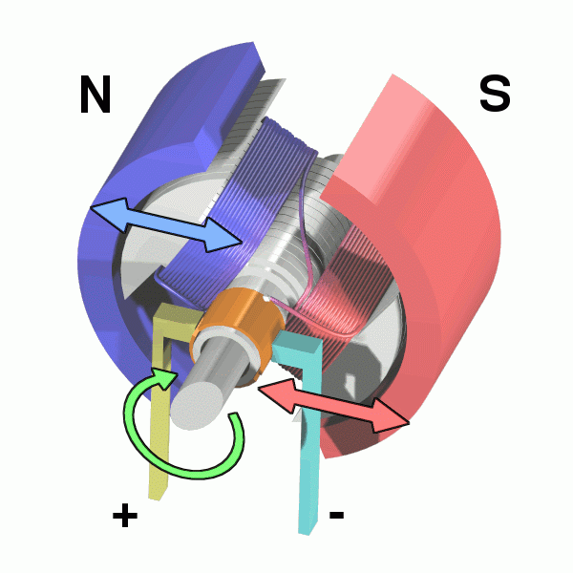
Operation

Slide 35
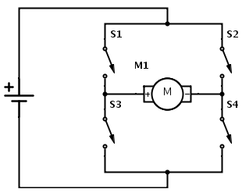
H-Bridge

Slide 36
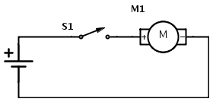
Flyback
When S1 is open after the motor has been running, M1 becomes a big inductor
It will drive up the voltage on GND
Potentially damaging/interfering with other parts of the circuit
This is called “fly back”

Slide 37
Flyback

Slide 38
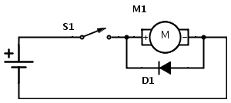
Flyback Diode
Adding a diode, allows the current to loop around through the motor and eventually dissipate

Slide 39
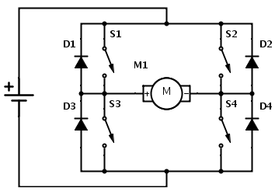
H-Bridge

Slide 40
Control
How would you control your motor’s speed?

Slide 41
Control
How would you control your motor’s speed?
Speed ∝Voltage ∝Current
So, vary the input voltage
Generating varying voltages is non-trivial
You need an digital-to-analog converter
Really, we just need the average voltage to vary

Slide 42
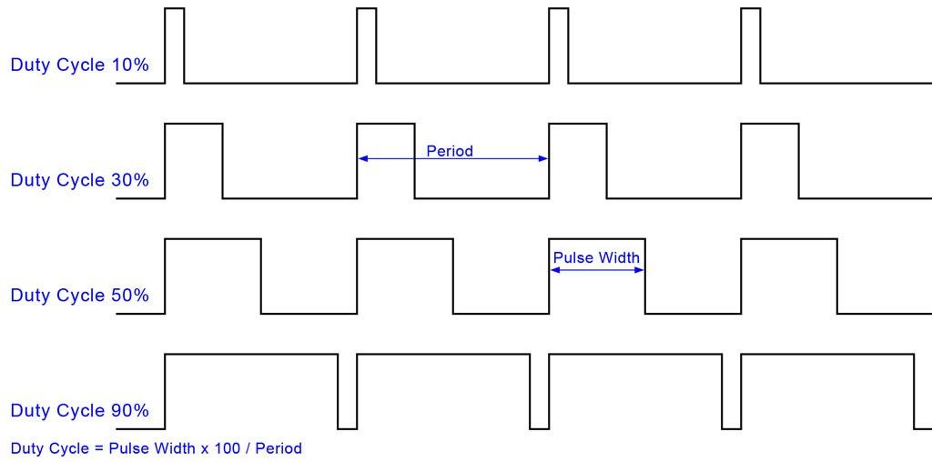
Pulse-width Modulation (PWM)

Slide 43
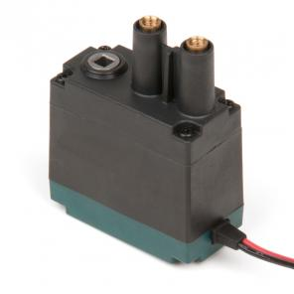
Selection
Free Speed:100 rpm
Stall Torque:8.6 in-lbs
Stall Current:2.6A
Free Current:0.18A
Specifications at 7.2V

Slide 44
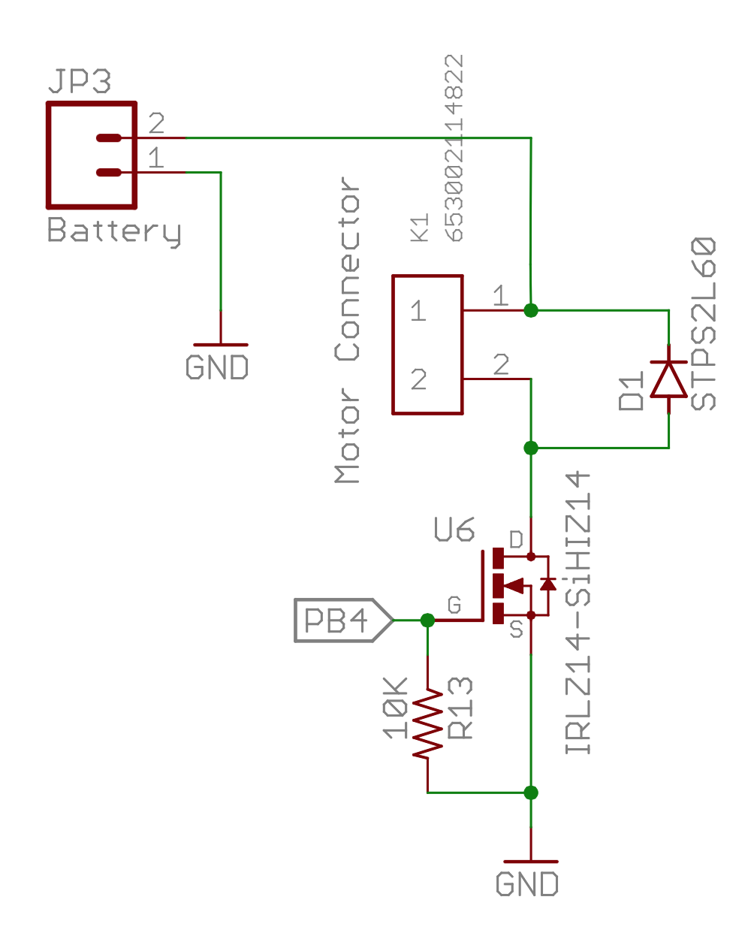
Our Motor Circuits

Slide 45
Analog IO in Arduino
The red board board has several analog pins
analogRead()
Takes a voltage between GND and Vcc and maps it to 0—1024
analogWrite ()
Takes a value, x, between 0 (off) and 255 (on) and sets the duty cycle to x/255.

